Slide 1



Spring Security: Authentication and Authorization
Presenting to: Opus Consulting Solutions
25-Apr-2024
Anand Kane

Slide 2


Agenda
Spring Security overview
Features of Spring Security
Authentication:
Minimal implementation: Demo the most basic Spring Security implementation.
Architecture overview
Explore various components of Spring Security
Understand the authentication request flow
Identify various extensibility options
Examples of customized authentication
Authorization:
Request based authorization
Method based authorization (Method level security)
Q&A

Slide 3

Overview
Spring Security
is a framework that provides authentication, authorization, and protection against common attacks.
is the de-facto standard for securing Spring-based applications.
provides support for securing both Servlet and WebFlux applications.
integrates with servlet application by injecting its own chain of servlet filters into the application's filter chain.
is highly customizable by providing multiple extensibility options.
Notes:
Please use these blocks and resize as per your need . Do not alter colours and thickness

Slide 4
Features
Authentication
Way of establishing identity of a user who is trying to access resources of an application.
Spring Security provides out the box support for basic (username and password) based user authentication.
Supports integration with external systems like LDAP and OAuth2 servers like Okta, KeyCloak etc for user authentication.
Supports authentication for both, Servlet and WebFlux applications.
Notes:
Please use these blocks and resize as per your need . Do not alter colours and thickness

Slide 5
Features (continued…)
Authorization
Way of establishing who can perform which actions on resources of an application.
Spring Security provides comprehensive support for
Role-based access control (RBAC)
Attribute-based access control (ABAC)
Expression-based access control (EL)
Provides 'defense in depth' by allowing for request-based authorization and method-based authorization.
Supports token based (typically JWT) authorization when integrated with external systems like LDAP and OAuth2 servers.
Notes:
Please use these blocks and resize as per your need . Do not alter colours and thickness

Slide 6
Features (continued…)
Protection Against Exploits
Spring Security provides protection against common exploits including,
Cross-site scripting (XSS)
Cross-site request forgery (CSRF)
Session fixation
SQL injection
Whenever possible, the protection is enabled by default.
Notes:
Please use these blocks and resize as per your need . Do not alter colours and thickness

Slide 7
Features (continued…)
Integration
Spring Security integrates seamlessly with a number of other Spring components including,
Spring Boot
Spring Data
Spring MVC
Spring Web Services
Notes:
Please use these blocks and resize as per your need . Do not alter colours and thickness

Slide 8
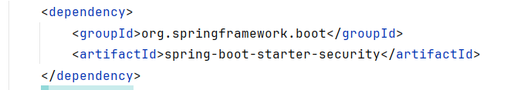
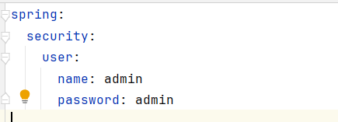
Authentication: Minimal Implementation
Spring Security is enabled just by having the below dependency. A user with username ‘user’ and a dynamically generated password can be used for authentication.
The defaults can be overridden as below.
Notes:
Please use these blocks and resize as per your need . Do not alter colours and thickness

Slide 9
Authentication: Minimal Implementation
Demo
Notes:
Please use these blocks and resize as per your need . Do not alter colours and thickness

Slide 10
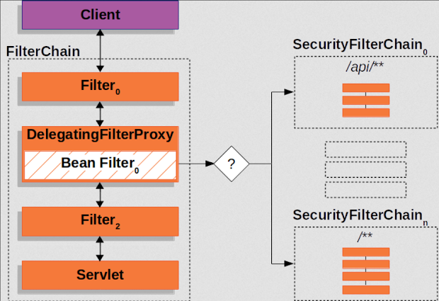
Authentication: Architecture Overview
Filter chain
Two in the filter chain are AuthenticationFilter and AauthorizationFilter
Notes:
Please use these blocks and resize as per your need . Do not alter colours and thickness

Slide 11
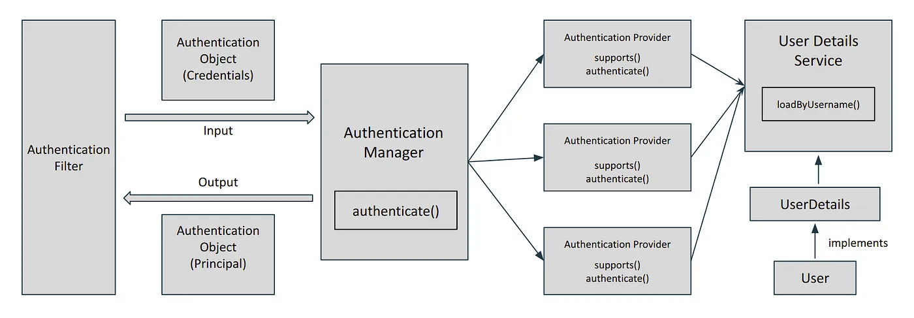
Authentication: Architecture Overview
Notes:
Please use these blocks and resize as per your need . Do not alter colours and thickness

Slide 12
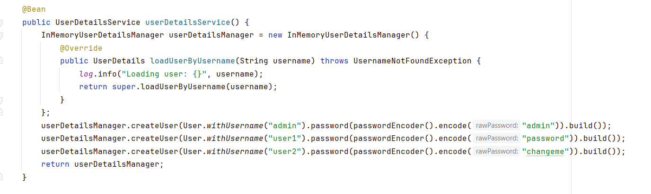
Authentication: Custom User Details Service
Configure custom user details service in a security configuration class as below
Notes:
Please use these blocks and resize as per your need . Do not alter colours and thickness

Slide 13
Authentication: Custom User Details Service
Demo
Notes:
Please use these blocks and resize as per your need . Do not alter colours and thickness

Slide 14
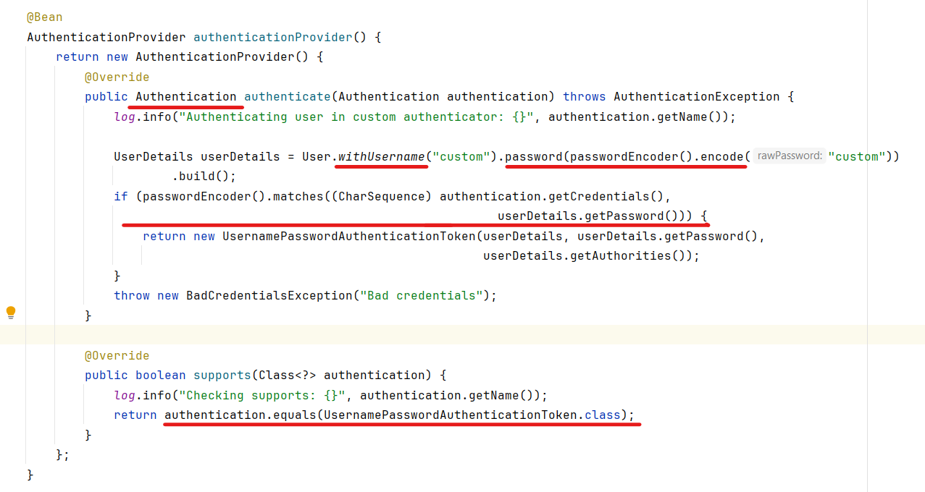
Authentication: Custom Authentication Provider
Configure custom authentication provider in a security configuration class as below
Notes:
Please use these blocks and resize as per your need . Do not alter colours and thickness

Slide 15
Authentication: Custom Authentication Provider
Demo
Notes:
Please use these blocks and resize as per your need . Do not alter colours and thickness

Slide 16
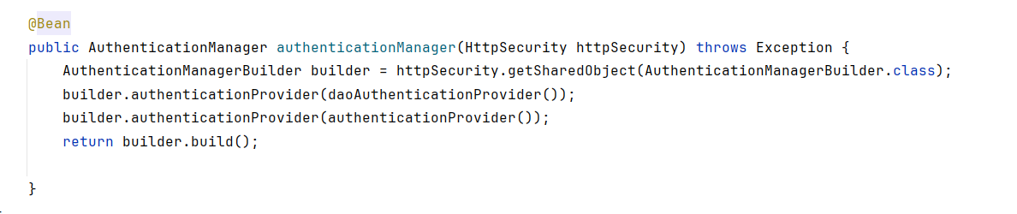
Authentication: Multiple Authentication Providers
Configure multiple authentication providers in a security configuration class as below
Notes:
Please use these blocks and resize as per your need . Do not alter colours and thickness

Slide 17
Authentication: Multiple Authentication Providers
Demo
Notes:
Please use these blocks and resize as per your need . Do not alter colours and thickness

Slide 18
Authorization: Customer CRUD operations
Users with CUSTOMER_ADMIN role can perform all operations on customer resource.
Users with CUSTOMER_MANAGER can perform all operations accept creating and deleting users.
Users with CUSTOMER roles can only view and edit their own information.
Notes:
Please use these blocks and resize as per your need . Do not alter colours and thickness

Slide 19
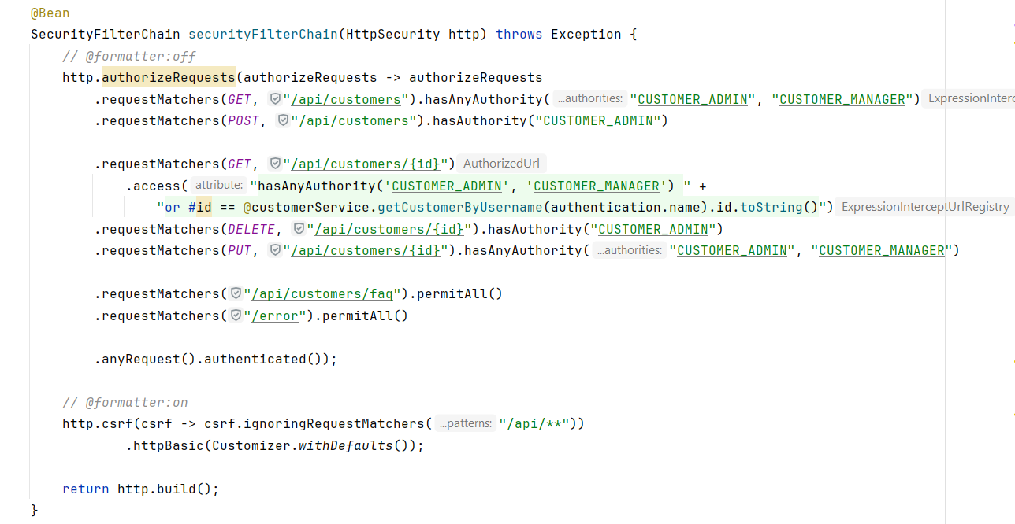
Authorization: Request Based
Configure request-based authorization as in a security configuration class as below
Notes:
Please use these blocks and resize as per your need . Do not alter colours and thickness

Slide 20
Authorization: Request Based
Demo
Notes:
Please use these blocks and resize as per your need . Do not alter colours and thickness

Slide 21
Authorization: Method Based
Method-based authorization (method level security) can be configured with the below method annotations.
preAuthorize: Apply authorization rules before invoking method
postAuthorize: Apply authorization rules after method execution
preFilter: Filter records from collection passed as parameter to the method
postFilter: Filter records from the collection returned from the method
Notes:
Please use these blocks and resize as per your need . Do not alter colours and thickness

Slide 22
Authorization: Method Based
Demo
Notes:
Please use these blocks and resize as per your need . Do not alter colours and thickness

Slide 23



Q & A
Thank You.
2500 Northwinds Pkwy, Suite 630, Alpharetta 30009
@opusconsultingsolutions
https://www.opusconsulting.com/
@consultopus

